Slide 1
Markov Chains
Chapter 16
Markov Chains - <number>

Slide 2
Overview
Stochastic Process
Markov Chains
Chapman-Kolmogorov Equations
State classification
First passage time
Long-run properties
Absorption states
Markov Chains - <number>

Slide 3
Event vs. Random Variable
What is a random variable?
(Remember from probability review)
Examples of random variables:
Markov Chains - <number>

Slide 4
Stochastic Processes
Suppose now we take a series of observations of that random variable.
A stochastic process is an indexed collection of random variables {X_{t}}, where t is the index from a given set T.
(The index t often denotes time.)
Examples:
Markov Chains - <number>

Slide 5
Space of a Stochastic Process
The value of X_{t} is the characteristic of interest
X_{t} may be continuous or discrete
Examples:
In this class we will only consider discrete variables
Markov Chains - <number>

Slide 6
States
We’ll consider processes that have a finite number of possible values for X_{t}
Call these possible values states
(We may label them 0, 1, 2, …, M)
These states will be mutually exclusive and exhaustive
  What do those mean?
  Mutually exclusive:
  Exhaustive:
Markov Chains - <number>

Slide 7
Weather Forecast Example
Suppose today’s weather conditions depend only on yesterday’s weather conditions
If it was sunny yesterday, then it will be sunny again today with probability p
If it was rainy yesterday, then it will be sunny today with probability q
Markov Chains - <number>

Slide 8
Weather Forecast Example
What are the random variables of interest, Xt?
What are the possible values (states) of these random variables?
What is the index, t?
Markov Chains - <number>

Slide 9
Inventory Example
A camera store stocks a particular model camera
Orders may be placed on Saturday night and the cameras will be delivered first thing Monday morning
The store uses an (s, S) policy:
  If the number of cameras in inventory is greater than or equal to s, do not order any cameras
  If the number in inventory is less than s, order enough to bring the supply up to S
The store set s = 1 and S = 3
Markov Chains - <number>

Slide 10
Inventory Example
What are the random variables of interest, Xt?
What are the possible values (states) of these random variables?
What is the index, t?
Markov Chains - <number>

Slide 11
Inventory Example
Graph one possible realization of the stochastic process.
X_{t}
t
Markov Chains - <number>

Slide 12
Inventory Example
Describe X _{t+1} as a function of X_{t}, the number of cameras on hand at the end of the t^{th} week, under the (s=1, S=3) inventory policy
X₀ represents the initial number of cameras on hand
Let D_{i} represent the demand for cameras during week i
Assume D_{i}s are iid random variables
X _{t+1} =
Markov Chains - <number>

Slide 13
Markovian Property
A stochastic process {X_{t}} satisfies the Markovian property if
P(X_{t+1}=j | X₀=k₀, X₁=k₁, … , X_{t-1}=k_{t-1}, X_{t}=i) = P(X_{t+1}=j | X_{t}=i)
for all t = 0, 1, 2, … and for every possible state
What does this mean?
Markov Chains - <number>

Slide 14
Markovian Property
Does the weather stochastic process satisfy the Markovian property?
Does the inventory stochastic process satisfy the Markovian property?
Markov Chains - <number>

Slide 15
One-Step Transition Probabilities
The conditional probabilities P(X_{t+1}=j | X_{t}=i) are called the one-step transition probabilities
One-step transition probabilities are stationary if for all t
P(X_{t+1}=j | X_{t}=i) = P(X₁=j | X₀=i) = p_{ij}
Interpretation:
Markov Chains - <number>

Slide 16
One-Step Transition Probabilities
Is the inventory stochastic process stationary?
What about the weather stochastic process?
Markov Chains - <number>

Slide 17
Markov Chain Definition
A stochastic process {X_{t}, t = 0, 1, 2,…} is a finite-state Markov chain if it has the following properties:
  A finite number of states
  The Markovian property
  Stationary transition properties, p_{ij}
  A set of initial probabilities, P(X₀=i), for all states i
Markov Chains - <number>

Slide 18
Markov Chain Definition
Is the weather stochastic process a Markov chain?
Is the inventory stochastic process a Markov chain?
Markov Chains - <number>

Slide 19
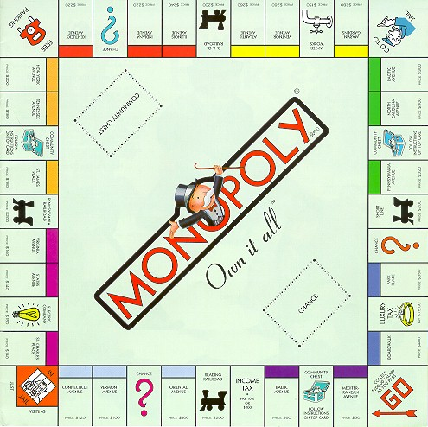
Monopoly Example
You roll a pair of dice to advance around the board
If you land on the “Go To Jail” square, you must stay in jail until you roll doubles or have spent three turns in jail
Let X_{t} be the location of your token on the Monopoly board after t dice rolls
  Can a Markov chain be used to model this game?
  If not, how could we transform the problem such that we can model the game with a Markov chain?
… more in Lab 3 and HW
Markov Chains - <number>

Slide 20
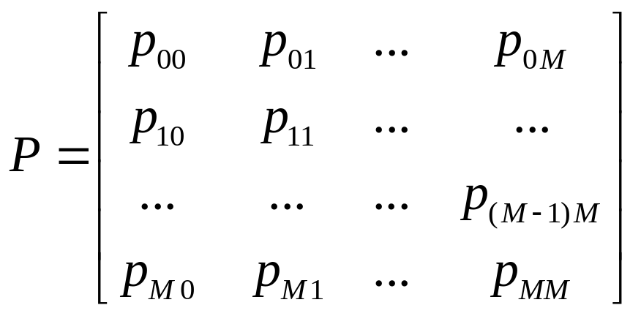
Transition Matrix
To completely describe a Markov chain, we must specify the transition probabilities,
p_{ij} = P(X_{t+1}=j | X_{t}=i)
in a one-step transition matrix, P:
Markov Chains - <number>

Slide 21
Markov Chain Diagram
The Markov chain with its transition probabilities can also be represented in a state diagram
Examples
Weather
Inventory
Markov Chains - <number>

Slide 22
Weather Example
Transition Probabilities
Calculate P, the one-step transition matrix, for the weather example.
P =
Markov Chains - <number>

Slide 23
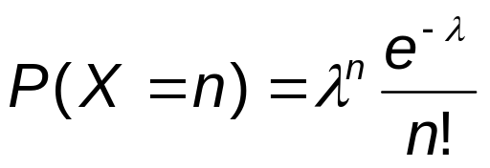
Inventory Example
Transition Probabilities
Assume D_{t} ~ Poisson(λ=1) for all t
Recall, the pmf for a Poisson random variable is
From the (s=1, S=3) policy, we know
X _{t+1}= Max {3 - D_{t+1}, 0} if X_{t} < 1 (Order)
Max {X_{t} - D_{t+1}, 0} if X_{t} ≥ 1 (Don’t order)
n = 1, 2,…
Markov Chains - <number>

Slide 24
Inventory Example
Transition Probabilities
Calculate P, the one-step transition matrix
P =
Markov Chains - <number>

Slide 25
n-step Transition Probabilities
If the one-step transition probabilities are stationary, then the n-step transition probabilities are written:
P(X_{t+n}=j | X_{t}=i) = P(X_{n}=j | X₀=i) for all t
= p_{ij} ^{(n)}
Interpretation:
Markov Chains - <number>

Slide 26
Inventory Example n-step Transition Probabilities
p₁₂⁽³⁾ = conditional probability that…
starting with one camera, there will be two cameras after three weeks
A picture:
Markov Chains - <number>

Slide 27
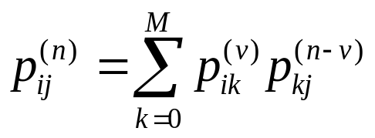
Chapman-Kolmogorov Equations
for all i, j, n and 0 ≤ v ≤ n
Consider the case when v = 1:
Markov Chains - <number>

Slide 28
Chapman-Kolmogorov Equations
The p_{ij}^{(n)} are the elements of the n-step transition matrix, P^{(n)}
Note, though, that
P^{(n)} =
Markov Chains - <number>

Slide 29
Weather Example n-step Transitions
Two-step transition probability matrix:
P⁽²⁾ =
Markov Chains - <number>

Slide 30
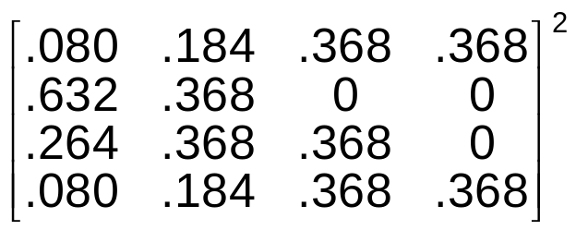
Inventory Example n-step Transitions
Two-step transition probability matrix:
P⁽²⁾ =
=
Markov Chains - <number>

Slide 31
Inventory Example n-step Transitions
p₁₃⁽²⁾ = probability that the inventory goes from 1 camera to 3 cameras in two weeks
=
  (note: even though p₁₃ = 0)
Question:
Assuming the store starts with 3 cameras, find the probability there will be 0 cameras in 2 weeks
Markov Chains - <number>

Slide 32
(Unconditional) Probability in state j at time n
The transition probabilities p_{ij} and p_{ij}^{(n)} are conditional probabilities
How do we “un-condition” the probabilities?
That is, how do we find the (unconditional) probability of being in state j at time n?
A picture:
Markov Chains - <number>

Slide 33
Inventory Example
Unconditional Probabilities
If initial conditions were unknown, we might assume it’s equally likely to be in any initial state
Then, what is the probability that we order (any) camera in two weeks?
Markov Chains - <number>

Slide 34
Steady-State Probabilities
As n gets large, what happens?
What is the probability of being in any state?
(e.g. In the inventory example, what happens as more and more weeks go by?)
Consider the 8-step transition probability for the inventory example.
P⁽⁸⁾ = P⁸ =
Markov Chains - <number>

Slide 35
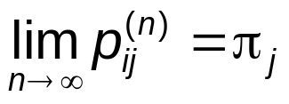
Steady-State Probabilities
In the long-run (e.g. after 8 or more weeks),
the probability of being in state j is …
These probabilities are called the steady state probabilities
Another interpretation is that π_{j} is the fraction of time the process is in state j (in the long-run)
This limit exists for any “irreducible ergodic” Markov chain (More on this later in the chapter)
Markov Chains - <number>

Slide 36
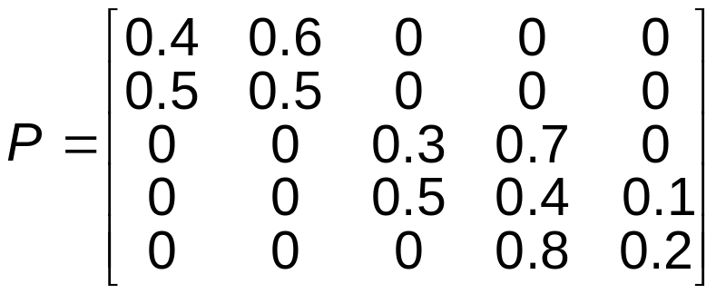
State Classification
Accessibility
Draw the state diagram representing this example
Markov Chains - <number>

Slide 37
State Classification
Accessibility
State j is accessible from state i if
p_{ij}^{(n)} >0 for some n>= 0
This is written j ← i
For the example, which states are accessible from which other states?
Markov Chains - <number>

Slide 38
State Classification
Communicability
States i and j communicate if state j is accessible from state i, and state i is accessible from state j (denote j ↔ i)
Communicability is
  Reflexive: Any state communicates with itself, because
  p _{ii} = P(X₀=i | X₀=i ) =
  Symmetric: If state i communicates with state j, then state j communicates with state i
  Transitive: If state i communicates with state j, and state j communicates with state k, then state i communicates with state k
For the example, which states communicate with each other?
Markov Chains - <number>

Slide 39
State Classes
Two states are said to be in the same class if the two states communicate with each other
Thus, all states in a Markov chain can be partitioned into disjoint classes.
How many classes exist in the example?
Which states belong to each class?
Markov Chains - <number>

Slide 40
Irreducibility
A Markov Chain is irreducible if all states belong to one class (all states communicate with each other)
If there exists some n for which p_{ij}^{(n)} >0 for all i and j, then all states communicate and the Markov chain is irreducible
Markov Chains - <number>

Slide 41
Gambler’s Ruin Example
Suppose you start with $1
Each time the game is played, you win $1 with probability p, and lose $1 with probability 1-p
The game ends when a player has a total of $3 or else when a player goes broke
Does this example satisfy the properties of a Markov chain? Why or why not?
Markov Chains - <number>

Slide 42
Gambler’s Ruin Example
State transition diagram and one-step transition probability matrix:
How many classes are there?
Markov Chains - <number>

Slide 43
Transient and Recurrent States
State i is said to be
  Transient if there is a positive probability that the process will move to state j and never return to state i
  (j is accessible from i, but i is not accessible from j)
  Recurrent if the process will definitely return to state i
  (If state i is not transient, then it must be recurrent)
  Absorbing if p _{ii} = 1, i.e. we can never leave that state
  (an absorbing state is a recurrent state)
Recurrence (and transience) is a class property
In a finite-state Markov chain, not all states can be transient
  Why?
Markov Chains - <number>

Slide 44
Transient and Recurrent States
Examples
Gambler’s ruin:
  Transient states:
  Recurrent states:
  Absorbing states:
Inventory problem
  Transient states:
  Recurrent states:
  Absorbing states:
Markov Chains - <number>

Slide 45
Periodicity
The period of a state i is the largest integer t (t > 1), such that
p_{ii}^{(n)} = 0 for all values of n other than n = t, 2t, 3t, …
State i is called aperiodic if there are two consecutive numbers s and (s+1) such that the process can be in state i at these times
Periodicity is a class property
If all states in a chain are recurrent, aperiodic, and communicate with each other, the chain is said to be ergodic
Markov Chains - <number>

Slide 46
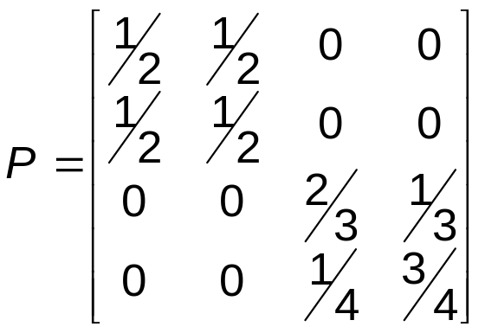
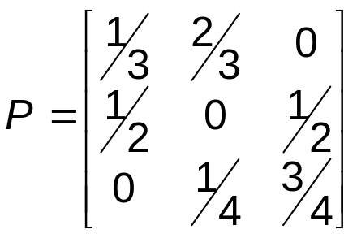
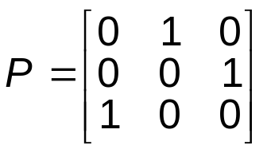
Periodicity
Examples
Which of the following Markov chains are periodic?
Which are ergodic?
Markov Chains - <number>

Slide 47
Positive and Null Recurrence
A recurrent state i is said to be
  Positive recurrent if, starting at state i, the expected time for the process to reenter state i is finite
  Null recurrent if, starting at state i, the expected time for the process to reenter state i is infinite
For a finite state Markov chain, all recurrent states are positive recurrent
Markov Chains - <number>

Slide 48
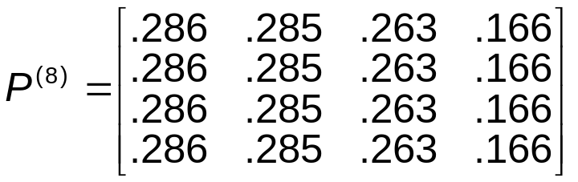
Steady-State Probabilities
Remember, for the inventory example we had
For an irreducible ergodic Markov chain,
where π_{j} = steady state probability of being in state j
How can we find these probabilities without calculating P^{(n)} for very large n?
Markov Chains - <number>

Slide 49
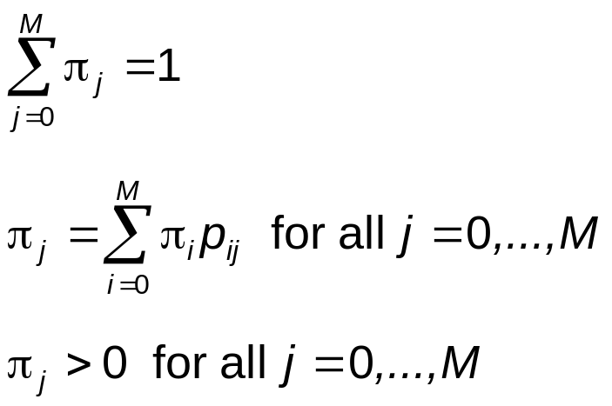
Steady-State Probabilities
The following are the steady-state equations:
In matrix notation we have π^{T}P = π^{T}
Markov Chains - <number>

Slide 50
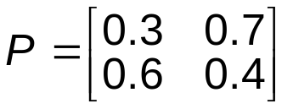
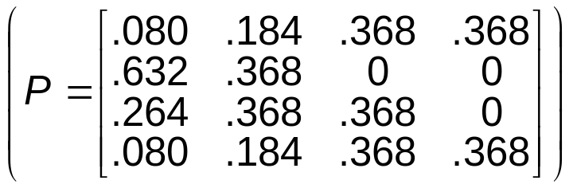
Steady-State Probabilities
Examples
Find the steady-state probabilities for
  Inventory example
Markov Chains - <number>

Slide 51
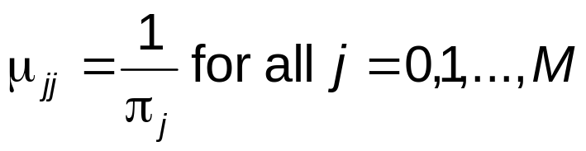
Expected Recurrence Times
The steady state probabilities, π_{j} , are related to the expected recurrence times, μ_{jj}, as
Markov Chains - <number>

Slide 52
Steady-State Cost Analysis
Once we know the steady-state probabilities, we can do some long-run analyses
Assume we have a finite-state, irreducible MC
Let C(X_{t}) be a cost (or other penalty or utility function) associated with being in state X_{t} at time t
The expected average cost over the first n time steps is
The long-run expected average cost per unit time is
Markov Chains - <number>

Slide 53
Steady-State Cost Analysis
Inventory Example
Suppose there is a storage cost for having cameras on hand:
C(i) = 0 if i = 0
2 if i = 1
8 if i = 2
18 if i = 3
The long-run expected average cost per unit time is
Markov Chains - <number>

Slide 54
First Passage Times
The first passage time from state i to state j is the number of transitions made by the process in going from state i to state j for the first time
When i = j, this first passage time is called the recurrence time for state i
Let f_{ij}^{(n)} = probability that the first passage time from state i to state j is equal to n
Markov Chains - <number>

Slide 55
First Passage Times
The first passage time probabilities satisfy a recursive relationship
f_{ij}⁽¹⁾ = p_{ij}
f_{ij} ⁽²⁾ = p_{ij} ⁽²⁾ – f_{ij}⁽¹⁾ p_{jj}
…
f_{ij}^{(n)} =
Markov Chains - <number>

Slide 56
First Passage Times
Inventory Example
Suppose we were interested in the number of weeks until the first order
Then we would need to know what is the probability that the first order is submitted in
  Week 1?
  Week 2?
  Week 3?
Markov Chains - <number>

Slide 57
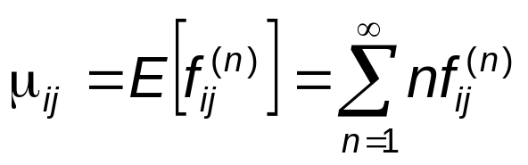
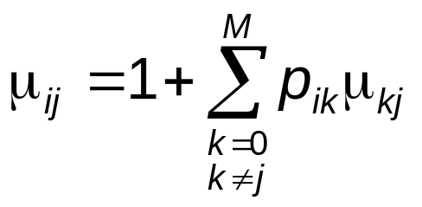
Expected First Passage Times
The expected first passage time from state i to state j is
Note, though, we can also calculate μ_{ij} using recursive equations
Markov Chains - <number>

Slide 58
Expected First Passage Times
Inventory Example
Find the expected time until the first order is submitted μ₃₀=
Find the expected time between orders
μ₀₀=
Markov Chains - <number>

Slide 59
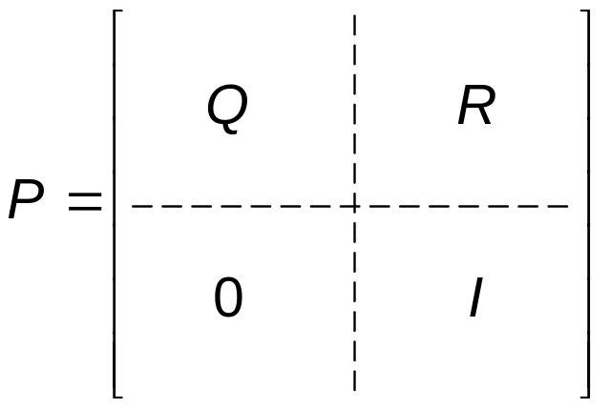
Absorbing States
Recall a state i is an absorbing state if p_{ii}=1
Suppose we rearrange the one-step transition probability matrix such that
Transient
Absorbing
Example: Gambler’s ruin
Markov Chains - <number>

Slide 60
Absorbing States
If we are in a transient state i, the expected number of periods spent in transient state j until absorption is the ij ^{th} element of
(I-Q)⁻¹
If we are in a transient state i, the probability of being absorbed into absorbing state j is the ij ^{th} element of
(I-Q)⁻¹R
Markov Chains - <number>

Slide 61
Accounts Receivable Example
At the beginning of each month, each account may be in one of the following states:
  0: New Account
  1: Payment on account is 1 month overdue
  2: Payment on account is 2 months overdue
  3: Payment on account is 3 months overdue
  4: Account paid in full
  5: Account is written off as bad debt
Markov Chains - <number>

Slide 62
Accounts Receivable Example
Let p₀₁ = 0.6, p₀₄ = 0.4,
p₁₂ = 0.5, p₁₄ = 0.5,
p₂₃ = 0.4, p₂₄ = 0.6,
p₃₄ = 0.7, p₃₅ = 0.3,
p₄₄ = 1,
p₅₅ = 1
Write the P matrix in the I/Q/R form
Markov Chains - <number>

Slide 63
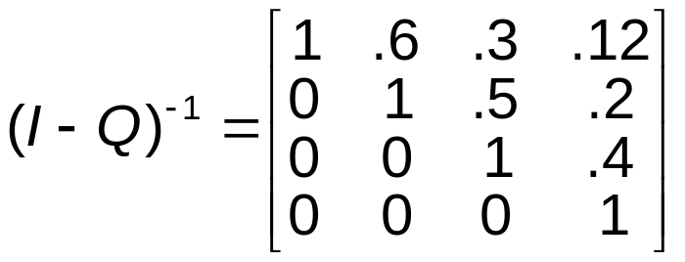
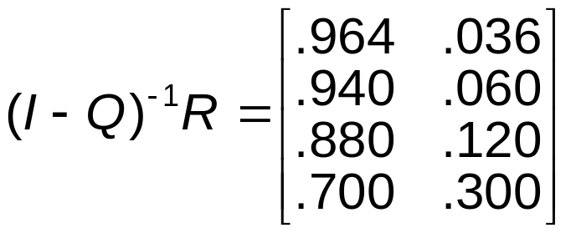
Accounts Receivable Example
We get
What is the probability a new account gets paid? Becomes a bad debt?
Markov Chains - <number>

